Slide 1

Big sir little sir responsibilities
Presented by Fred Serena

Slide 2
Agenda
Big Sir Responsibilities
Little Sir Responsibilities
Developing techniques for Branch Goals
You having a team behind you.
Maintain the financial health of the branch.

Slide 3
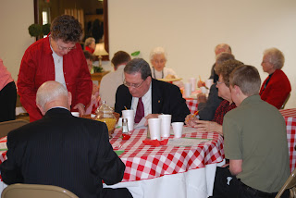

Introduction
LUNCHEONS
SIR ACTIVITIES
This Photo by Unknown Author is licensed under CC BY-NC-ND
What is the job description of a Big Sir
What is the job description of a Little Sir

Slide 4
BRANCH BIG SIR POSITION DESCRIPTION (Revised 10/2025) Position Purpose The Big Sir is the chief executive officer of the branch, a corporation under the laws of the State of California. A Branch may choose to use the title “Branch President” instead of Big Sir. If the Branch so elects, to avoid confusion with the President of SIR, Inc., the Branch must always refer to its chief executive officer by the title “Branch President.” Primary Responsibilities • • Serve as a Branch Officer and leader of the Branch Executive Committee. Responsible for implementing annual SIR Schedule of Branch Operations • Lead all the affairs of the Branch, subject to SIR bylaws, policies, required procedures, Branch regulations and the control of the Branch Executive Committee. • Ensure the BEC annually sets reasonable membership and other goals that address issues of importance to branch improvement and long-term branch survival. • Embrace RAMP (Recruiting, Activities, Member Relations, and Publicity/ Image), placing emphasis on establishing leaders for each function. • Preside at all meetings of the Branch and its Executive Committee. Little Sir shall preside in the absence of the Bir Sir. • Appoint chairmen of Branch administrative and activity committees to serve during his term. • Attend the State Annual Meeting and vote as required. Should he and the Little Sir not be able to attend, ensure the BEC appoints an elected officer to represent the Branch. • Ensure the Branch is represented at all State Trainings. • Act as an ex officio member of all committees. • Execute any document or other instrument authorized by the State Board • Ensure that the Monthly Branch Membership Status Report is submitted by the end of the month. • Ensure that Branch officers and committee chairmen receive necessary training for their positions. • May call special meetings of officers and members at his discretion with five days notice. • Respond to State SIR emails in a timely manner • Act as mentor to the Little Sir.

Slide 5

Developing Techniques for Branch Goals
Ensure leadership responsibilities are shared and manageable
Prevent burnout among current officers and committee chairman
Confirm continuity for key branch operations
Identify future leaders early
Build a strong leadership Bench
Leadership roles that appeal to
younger members
Develop short-term projects with a clear beginning and end
Defined goals and authority to act
Act as mentor to the Little Sir

Slide 6

BRANCH LITTLE SIR POSITION DESCRIPTION (REVISED) POSITION PURPOSE The primary purpose of the Little Sir position is to prepare to become the Big Sir. The Little Sir is a Branch Officer and a member of the Branch Executive Committee. “A Branch may choose to use the title “Branch Vice President” instead of Little Sir. If the Branch so elects, to avoid confusion with the Vice President of SIR, Inc., the Branch must always refer to its this officer by the title “Branch Vice President.”
PRIMARY RESPONSIBILITIES • Perform In the absence or inability of the Big Sir, or at his request all the duties of the Big Sir. • May be a member of any committee except the Nominating and Travel Committees. • Have such other powers and perform such other duties as may be prescribed by the Big Sir or the Branch Executive Committee. • Represent his Branch at the yearly SIR Training Session as The Big Sir Elect.. • Prepare for the opportunity to lead all of the affairs of the Branch, subject to SIR bylaws, Policies, Procedures, Branch regulations; and to lead the Branch Executive Committee. • Appoint chairmen of Branch administrative and activity committees to serve during his term, including an Auditing Committee and Nominating Committee prior to the end of his Little Sir term. • Understand the responsibilities of all committees. • Vote in the election of the Area Representative as a member of the Area’s Election Committee. • Perform other tasks and duties as assigned by the Big Sir
Presenters

Slide 7
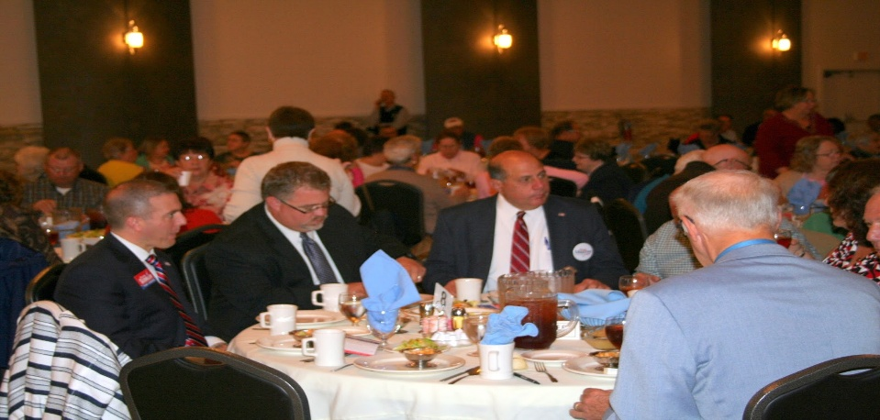
Little sir
The role of the Little Sir is to assist and support the Big Sir in the operation of the branch.
Prepare for the opportunity to lead branch at BEC meetings and luncheons.
Finding a Speaker for your luncheon.
Communicate with other branches in your area to create a pool of interesting speakers
Go to the sirinc.org website and visit other branch bulletins for ideas.
Create a team to share the search for luncheon speakers
4. Enlarging The Number of Activities
Work with your Activity Chairmen to increase visibility, be the conduit between the Activity Chairmen and the BEC.

Slide 8
Building your team of bec/chairmen
A GOOD TEAM | A GREAT TEAM | A GREAT TEAM
BIG SIR | BIG SIR | DIRECTORS (MAX 6)
LITTLE SIR | LITTLE SIR | MEMBERSHIP CHAIRMAN
SECRETARY | SECRETARY | ACTIVITY CHAIRMAN
TREASURER | ASSISTANT SECRETARY | PUBLICITY CHAIRMAN
DIRECTORS (MAX 6) | TREASURER | PUBLIC RELATIONS CHAIRMAN
CHAIRMEN | ASSISTANT TREASURER

Slide 9



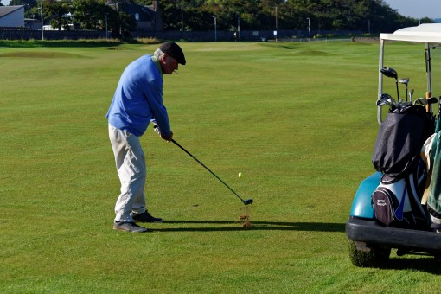
BUILD GROWTH BY ACTIVITIES

Slide 10
BEING FINANCIALLY SOLVENT
FINANCIAL, BRANCHES Big Sirs and members of BECs are to maintain high levels of fiduciary responsibility by furnishing guidance to Branch members who handle SIR funds. The participants in Branch luncheons, activities and events shall be charged enough to pay for all expenses associated with these functions. Income to cover Branch overhead expenses for the SIRinc assessment, newsletters, officer expenses, Branch promotion, etc. shall be derived from assessments of active Branch members. The preferred, and most effective, method for generating income is by requesting lump sum annual assessments from all members. The amount should be set according to each year’s budget. Branch Treasurers submit monthly Treasurers’ reports at the BEC meetings. As a guide Branch cash reserves should be budgeted at about $40.00 per member minimum at year end. (100 member branches should budget about $4,000 in cash reserves at year end). At any rate, cash reserves should be adequate to reimburse the luncheon’s food provider without requiring the Treasurer to quickly deposit funds to cover the amount of the bill. The Form 28, Monthly Cash Report, which includes branch financial data, is to be submitted by Branch Treasurers monthly by the end of the month to the SIRinc Assistant Treasurer, preferably electronically. It is intended to furnish data for reporting to the IRS and others as well as data for Area Representative to monitor branch financial health and provide assistance when appropriate. Form 28 Cumulative data is for a calendar year, but the End of December balance must transfer as the Opening Balance for January. It must not be changed.
Leadership Guide Handbook

